Slide 1

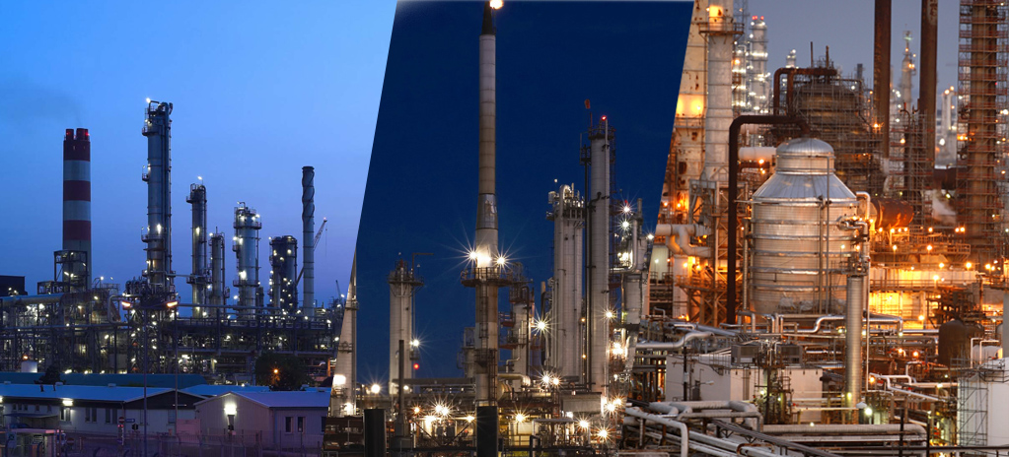
The Petroleum Refining Process
Presented By Group C
Jason Rako, Peter Holbeche, David Tian, Steven Xing and Brano Kopas
Notes:
1

Slide 2
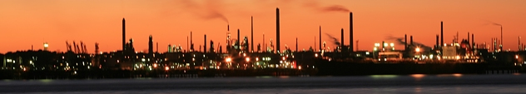
Our agenda
Crude in Canada
The Keystone Pipeline
What is Crude Oil?
Distilling Oil
Catalytic cracking and crackling
The Alkynation Process

Slide 3
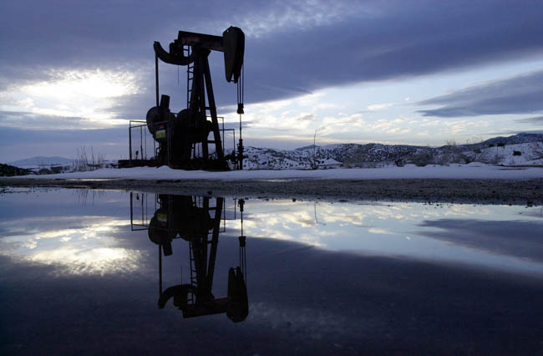
Crude Oil in Canada
Crude Oil in Canada
The Quick facts
Recovering the Oil
Production
The Market and the Economy

Slide 4

Crude Oil in Canada
The Quick facts
Canada has the third largest oil reserves in the world.
97 percent of these reserves are in the oil sands.
Canada’s oil sands are found in three deposits – the Athabasca, Peace River and Cold Lake deposits in Alberta and Saskatchewan.
The oil sands are at the surface near Fort McMurray but deeper underground in the other areas.

Slide 5
Crude Oil in Canada
Recovering the Oil
Oil sands are recovered using two main methods: mining and drilling (in situ). The method used depends on how deep the reserves are deposited.
Drilling: 80 percent of oil sands reserves are too deep to be mined so are recovered in place, or in situ, by drilling wells. Drilling (in situ) methods create minimal land disturbance and does not require tailing ponds.
Mining: 20 percent of the oil sands reserves are close enough to the surface to be mined using large shovels and trucks.

Slide 6
Crude Oil in Canada
Production
Canada has 175 billion barrels of oil that can be recovered economically with today’s technology. Of that number, 170 billion barrels are located in the oil sands.
Over the past 30 years, Canadian crude oil production has increased by 1.3 million barrels/day due to the growth in supply from oil sands.
By 2025, Canada's production is expected to be 4.7 million barrels per day.

Slide 7
Crude Oil in Canada
The Market and the Economy
Canada has the infrastructure to export crude oil from western Canada to eastern Canada, the U.S. and some offshore markets.
Canada’s oil sands industry continues to explore access to new markets in the U.S. and Asia.
New oil sands development is expected to contribute over $2.1 trillion dollars to the Canadian economy over the next 25 years – about $84 billion per year.
Employment in Canada as a result of new oil sands investments is expected to grow from 75,000 jobs in 2010 to 905,000 jobs in 2035.

Slide 8
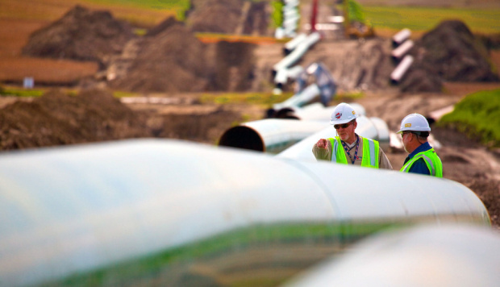
The Keystone Pipeline
The Keystone Pipeline
About the Project
Those Opposed
Some Myths
Where the Project Stands
Who Benefits?

Slide 9
The Keystone Pipeline
About the Project:
TransCanada began commercial operation of the first phase of the Keystone Pipeline System.
The proposed Keystone Gulf Coast Expansion Project is an approximate 2,673-kilometre, 36-inch crude oil pipeline that would begin at Hardisty, Alberta and extend southeast through Saskatchewan, Montana, South Dakota and Nebraska.
Keystone's first phase was highlighted by the conversion of a natural gas pipeline to crude oil pipeline and construction of an innovative bullet line that brings the crude oil non-stop from Canada to market hubs in the U.S. Midwest.

Slide 10
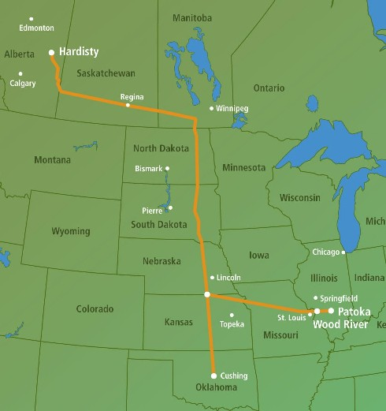
The Keystone Pipeline
About the Project:

Slide 11
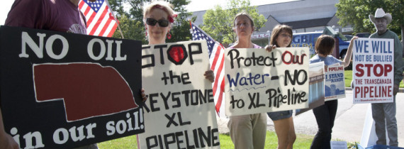
The Keystone Pipeline
Those Opposed:
There is growing opposition to the Keystone Pipeline project. Prominent figures against the pipeline are the Dalai Lama and Archbishop Desmond Tutu. But are the fears justified?

Slide 12
The Keystone Pipeline
Some Myths:
Keystone XL poses a threat to public safety and the environment because it will use thinner steel.
The Keystone XL Pipeline will be the newest, strongest and most advanced pipeline in operation in North America
Keystone XL will carry oil that is more corrosive and toxic than other types of crude oil.
Keystone XL will transport oil that is very similar to those already being transported and processed by other pipelines and refineries across the United States and have been for decades.

Slide 13
The Keystone Pipeline
Some Myths:
Local emergency responders are not equipped or trained to handle leaks or spills.
Keystone XL personnel would respond and manage clean-up operations should a spill or leak occur.
The crude oil Keystone XL will transport will be put on tankers and sent to China.
The crude oil Keystone XL will transport will not be shipped to China; it will be refined at U.S. refineries on the Gulf Coast to meet American demand for petroleum products.

Slide 14
The Keystone Pipeline
Where the Project Stands:
The Obama administration has currently delayed its decision on whether or not to allow the Keystone Pipeline project to continue. The decision was in response to concerned citizens from Nebraska, state officials and members of congress.
A major concern is that the pipeline crosses Nebraska's Ogallala aquifer, a source of clean water for 1.5 million people.
The decision is predicted to come after the 2012 elections.

Slide 15
The Keystone Pipeline
The Project's Benefits:
Canada will benefit from the mass sale of crude oil to the United States. western Canada’s total pipeline capacity would expand by 700,000 barrels per day. The total Canadian GDP impact would be about another $633 billion over 25 years.
For the United States, the project is estimated to create 20,000 American jobs and will add $20,000 to the American economy.
Who do you think is getting the better deal?

Slide 16
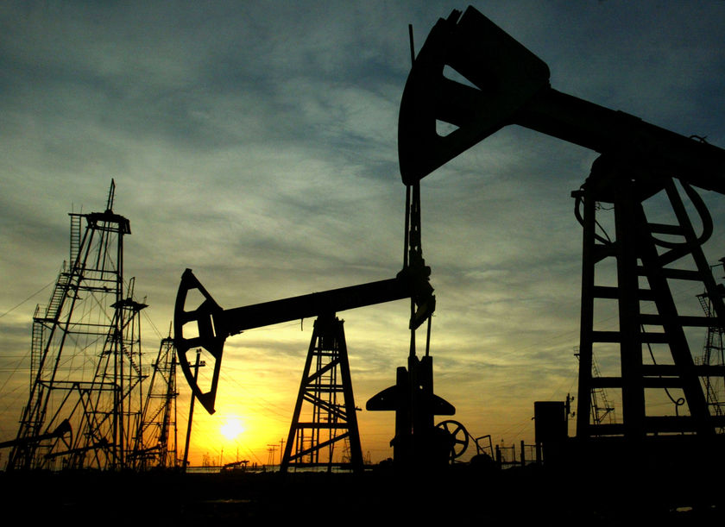
What is Crude Oil
What is Crude Oil
What is it Made of
Fractions of Crude Oil
Heavy and Light Crude Oil
Sulphur Content

Slide 17
What is Crude Oil?
Thousands of diamonds in the rough
Crude oil is not a single compound but thousands of different compounds, ranging from methane to asphalt, with varying proportions of paraffins, naphthenes, and aromatics.
The objective of crude distillation is to fractionate crude oil into light-end hydrocarbons (Ci-C4), naphtha, gasoline, kerosene, and diesel.
Each compound has its own boiling temperature, which is the key to separating each compound out of the crude oil mixture.

Slide 18
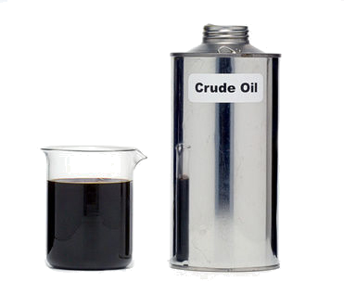
What is Crude Oil?
Discussion: Boiling a beaker of crude oil
You bring a beaker of oil to a boil (at about 66 Celsius) and held it at that temperature. The oil boils and then stops after a while. You add more heat and the oil begins to boil but stops again. What is happening?
Certain compounds evaporate at specific temperatures. Once a compound is evaporated, boiling will cease until the temperature is raised to boil off another compound.

Slide 19
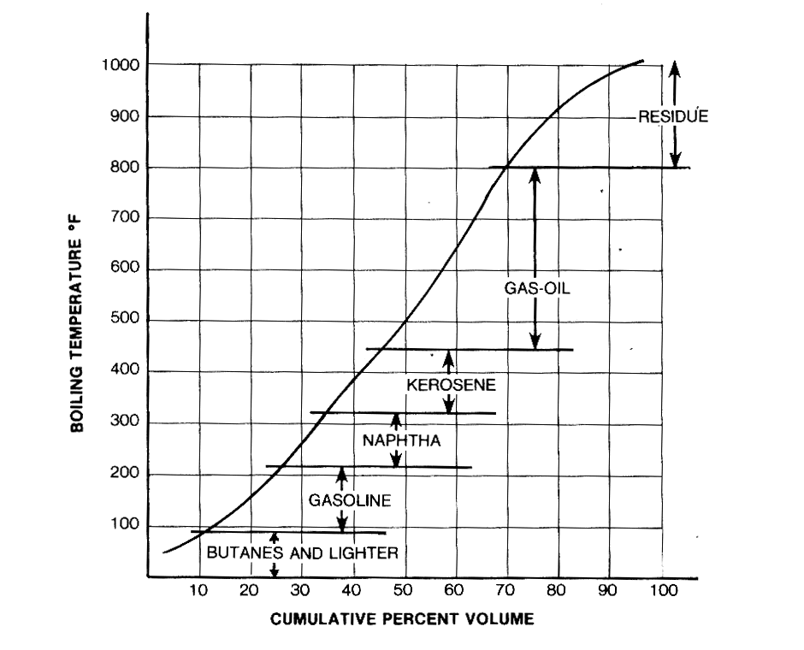
What is Crude Oil?
The Distillation Curve
Identifies evaporation points of desirable compounds
“Fractions” are the generic names that boil between two given temperatures.

Slide 20
What is Crude Oil?
Hydrocarbons
Molecules made only from the element Carbon and the element Hydrogen. The Length of the chains varies wildly, from five Carbon atoms long to 60 Carbons or more.
Fuels need to be very specific in terms of the length of the Carbon chain.
The boiling point of a Hydrocarbon fraction is dependent on the length of the Carbon chain.

Slide 21
What is Crude Oil?
Choice Cuts
Crude oil compositions vary wildly from region to region; no two crude oils are identical.
Light crude oils are better suited for the production of gasoline, naphtha and kerosene. These compounds boil out at lower temperatures.
Heavy crude oils are better suited for the production of gas-oil and residue.
The more carbon a compound has, the heavier it is and thus it has a higher boiling temperature.

Slide 22
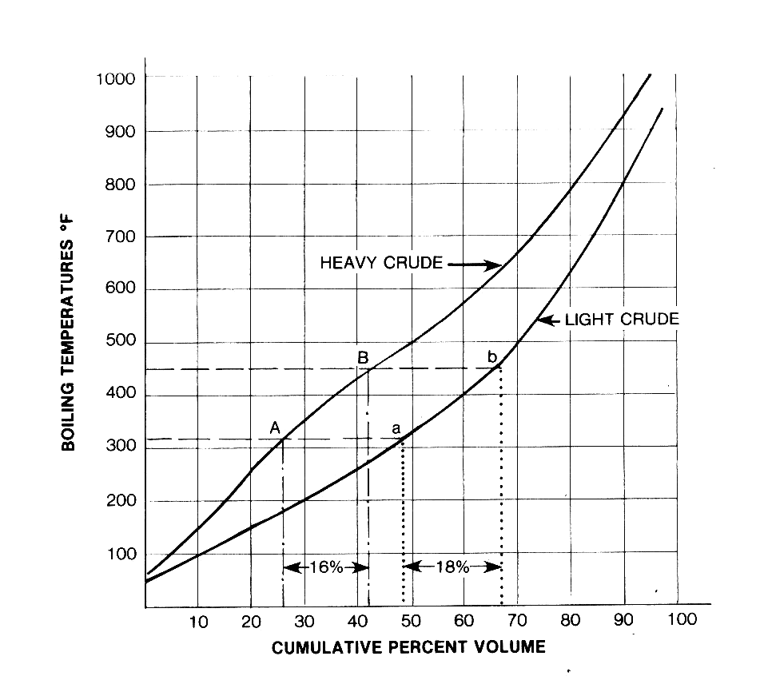
What is Crude Oil?
Choice Cuts Cont'd
Note that in a comparison between heavy and light oils, can produce a larger volume of lighter compounds. A company producing kerosene would prefer a light oil over a heavier oil.

Slide 23
What is Crude Oil?
Sources and “Assays”
Chevron trades and refines crude oils from North America, Latin America, Africa, Europe, Central Asia, the Middle East and the Far East.
To assess the suitability of a crude oil, laboratory technicians prepare “assays”. These documents detail the evaporation temperature and volumes of each compound in its liquid state. These calculations are then used to produce a distillation curve, much like the one on the previous slide.

Slide 24
What is Crude Oil?
Discussion: Sweet and Sour Oil
Where did the terms “sweet” and “sour” really come from?
In the early years of oil refining, the most-sought fraction was kerosene for lamps (instead of whale oil). It was found that an oil with a high-sulpher content would have a pungent odour and would accelerate the rate silver would tarnish.
Somewhere, for some reason, someone one discovered that kerosene with a high-sulpher content actually tasted sour; low sulpher oil had a sweeter taste. For the longest time, tasting the oil was the acceptable method of determining the best lamp oil.

Slide 25
What is Crude Oil
Sweet and Sour Oil Cont'd
The terms “sweet” and “sour” are still used in the industry today.
Sweet crude oils typically have a sulpher content of 0.5 percent or lower.
Sour crude oils typically have a sulpher content of 1.5 percent or more.
The middle ground is either called the intermediate sweet or intermediate sour zone (depending on your “taster”)

Slide 26
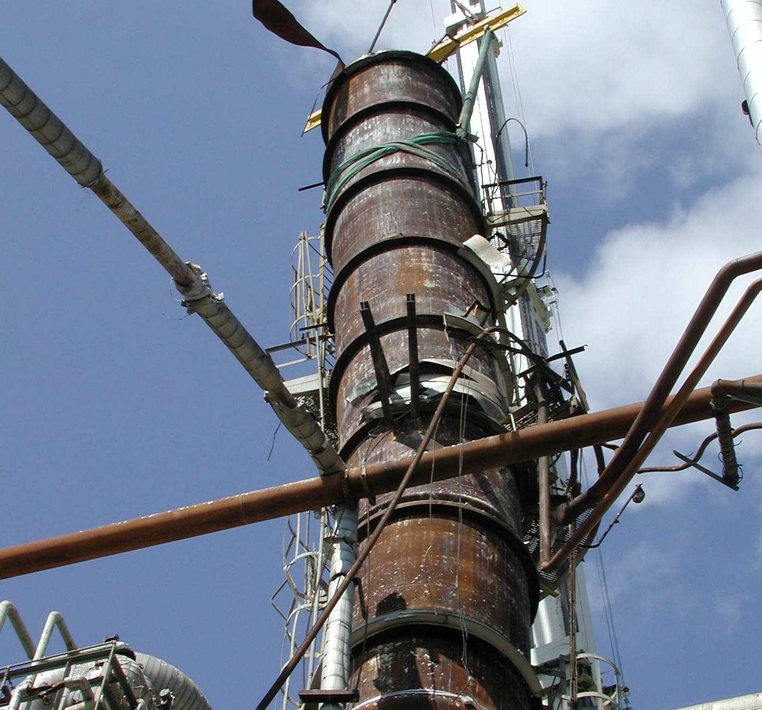
Distilling Crude Oil
Distilling Crude Oil
The basics of Distillation
Desalting the Oil
The Distillation Column
The Vacuum Tower
Reflux and Reboil

Slide 27
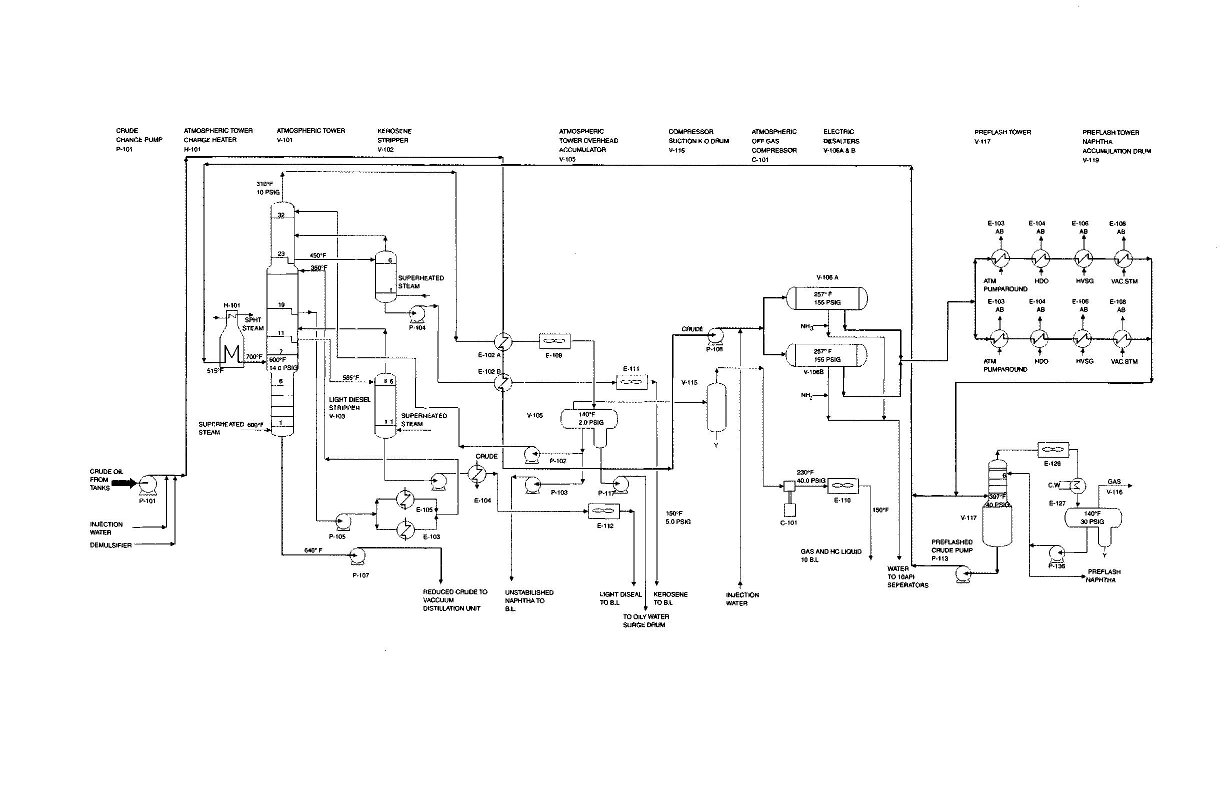
Distilling Crude Oil
The Basics of Distillation

Slide 28
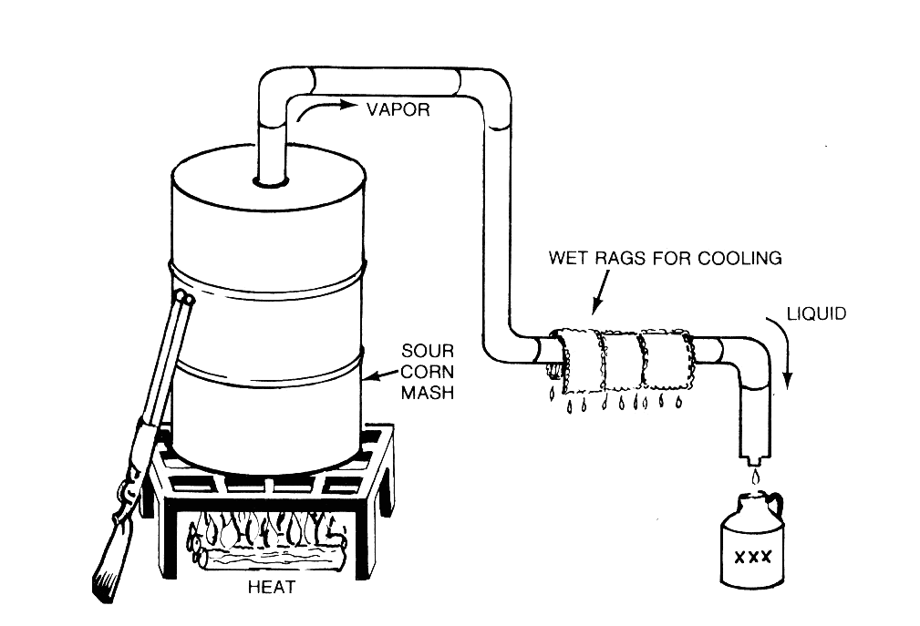
Distilling Crude Oil
The Basics of Distillation

Slide 29
Distilling Crude Oil
The Basics of Distillation
Crude oil is received from off-site storage tanks through booster pumps.
Pumped by charge pump and preheated in heat exchangers.
Small quantity of water and demulsifier chemicals is added before preheating.
The hot crude is fed to electric desalters to reduce the salt content.
The desalted crude is further heated through heat exchangers and admitted to pre-flash tower.

Slide 30
Distilling Crude Oil
The Basics of Distillation
Overhead vapour is cooled in pre-flash tower by exchanging heat with crude oil (condensed liquid naphtha is formed).
Crude is sent through heat exchangers to fired atmospheric heater and heated above 370 degrees Celsius.
Partially vaporized in the fired heater before entering the flash zone of the atmospheric tower.

Slide 31
Distilling Crude Oil
The First Step: Desalting the Oil
Crude desalting is the first processing step in a refinery which removes salts, water and solids from unrefined crude oil before it enters the distillation process.
Salt in the crude oil is in the form of dissolved or suspended salt crystals in water emulsified with the crude oil. The basic process of desalting is to wash the salt from crude oil with water
An important function of the desalting process is the removal of suspended solids from the crude oil. These are usually very fine sand and soil particles, iron oxides, and iron sulfide particles

Slide 32
Distilling Crude Oil
Desalting the Oil Cont'd
Reduced equipment fouling and corrosion and longer catalyst life in downstream processing units provide justification for this additional treatment
Desalting is carried out by emulsifying the crude oil with a ratio of 3 to 10 percent volume of water at a temperature of 200-3000F. Both the ratio of water to oil and the operating temperature are functions of the gravity of the crude oil.

Slide 33
Distilling Crude Oil
Desalting the Oil Cont'd
The salts are dissolved in the wash water and oil and water phases are separated in a settling vessel either by adding chemicals to assist in breaking up the emulsion or by the application of an electrostatic field to coalesce the droplets of saltwater more rapidly.
Either an AC or DC field may be used and potentials of 16,000-35,000V are used to promote coalescence. Efficiencies up to 90-95% water removal are achieved in a single stage and up to 99% in a two-stage desalting process.

Slide 34
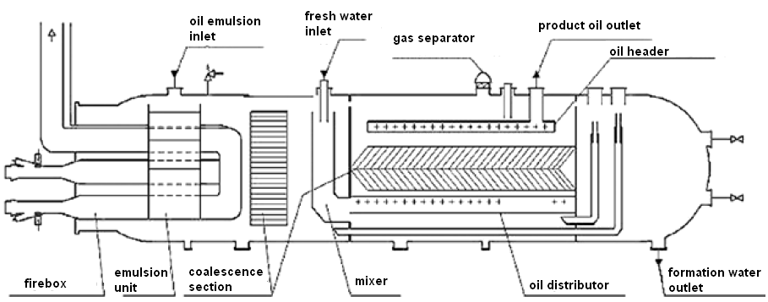
Distilling Crude Oil
Basic Oil Desalter Unit
Basic Oil Desalter Unit

Slide 35
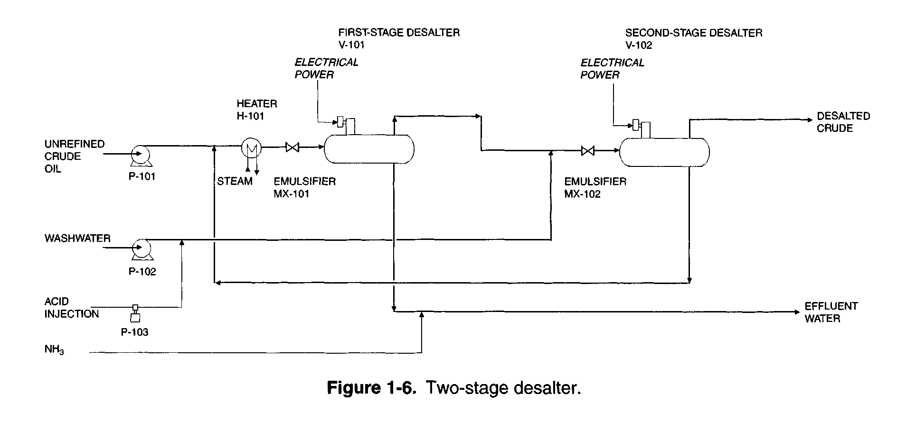
Distilling Crude Oil
PID of a Two-Stage Desalter Setup
PID of a Two-Stage Desalter

Slide 36
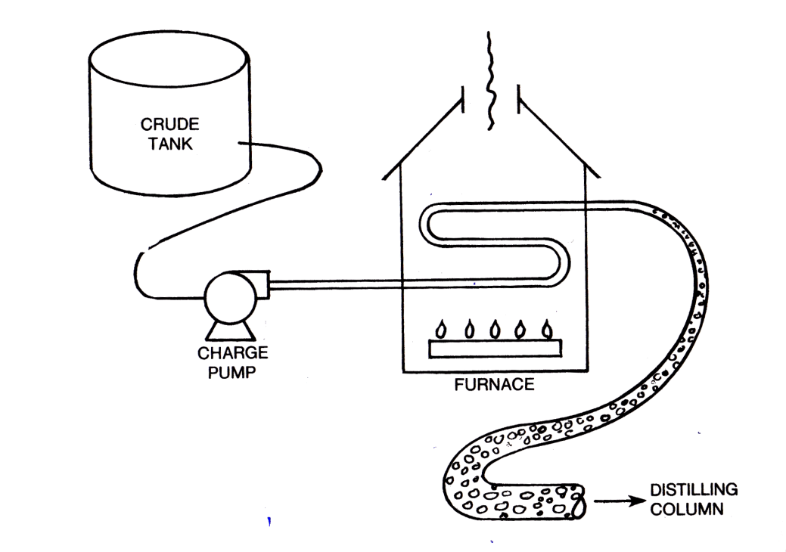
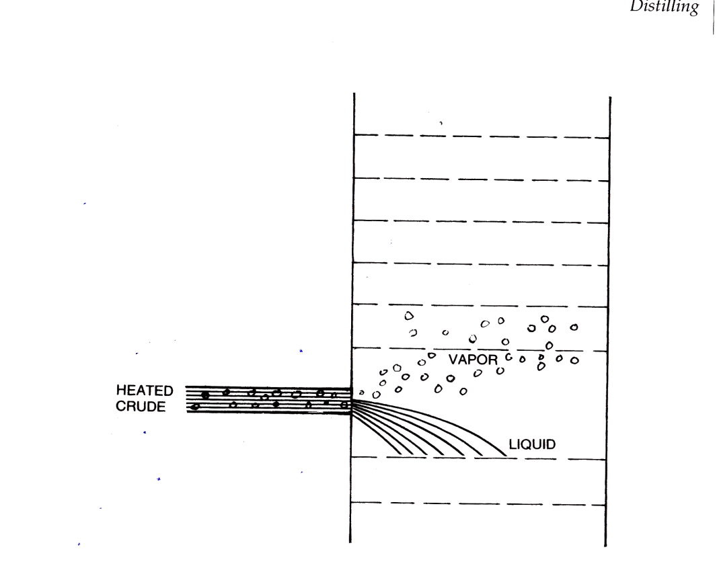
Distilling Crude Oil
The Second Step: The Distillation Column
After being desalted and preheated to about 400 Celsius, the crude oil is pumped into the distillation column.

Slide 37
Distilling Crude Oil
The Distillation Column Cont'd
Question: True or false; the heated crude enters the distillation tower as a fluid only.
The answer is false. Why?
At 400 degrees Celsius, many of the fractions have become vapour while while passing thorough the furnace and upon entering the furnace, which is at atmospheric pressure.
The temperature in the atmospheric distillation tower is set so that all those fractions with a Carbon chain length of 20 and below are evaporated from the crude mix.

Slide 38
Distilling Crude Oil
The Distillation Column Cont'd
Fractions with shorter chains evaporate more easily than those with longer chains.
Longer hydrocarbon molecules that condense at higher temperatures are collected at different points nearer the bottom of the column.
Heavier fractions are evaporated in the vacuum tower with similar temperature, but lower pressure.
Very few of the components come out of the fractional distillation column ready for market (further refining is required).

Slide 39
Distilling Crude Oil
The Distillation Column Cont'd
Light-end hydrocarbons are distilled off from heated crude oil at pressure slightly above atmospheric.
Tower overhead vapour is cooled by exchanging heat with crude oil and routed to overhead product accumulator.
Condensed naphtha in the accumulator is separated from water.

Slide 40
Distilling Crude Oil
The Distillation Column Cont'd
AT THE TOP OF THE COLUMN Short carbon chains Light molecules Low boiling points Gases & very runny liquids Very volatile Highly flammable Light colour | AT THE BOTTOM OF THE COLUMN Long carbon chains Heavy molecules High boiling points Thick, viscous liquids Low volatility Not very flammable Dark colour

Slide 41
Distilling Crude Oil
The Distillation Column Design
Inside the distillation column are a number of trays with perforations in them which permit the vapour to rise in the column.
Gravity causes the denser liquids to drop towards the bottom of the column while the less dense vapours move towards the top.
Devices called bubble caps are fitted on each perforation and force the vapours to bubble through the liquid on each try.
While bubbling through each tray, desenser compounds will condense out of the vapour and stay behind

Slide 42
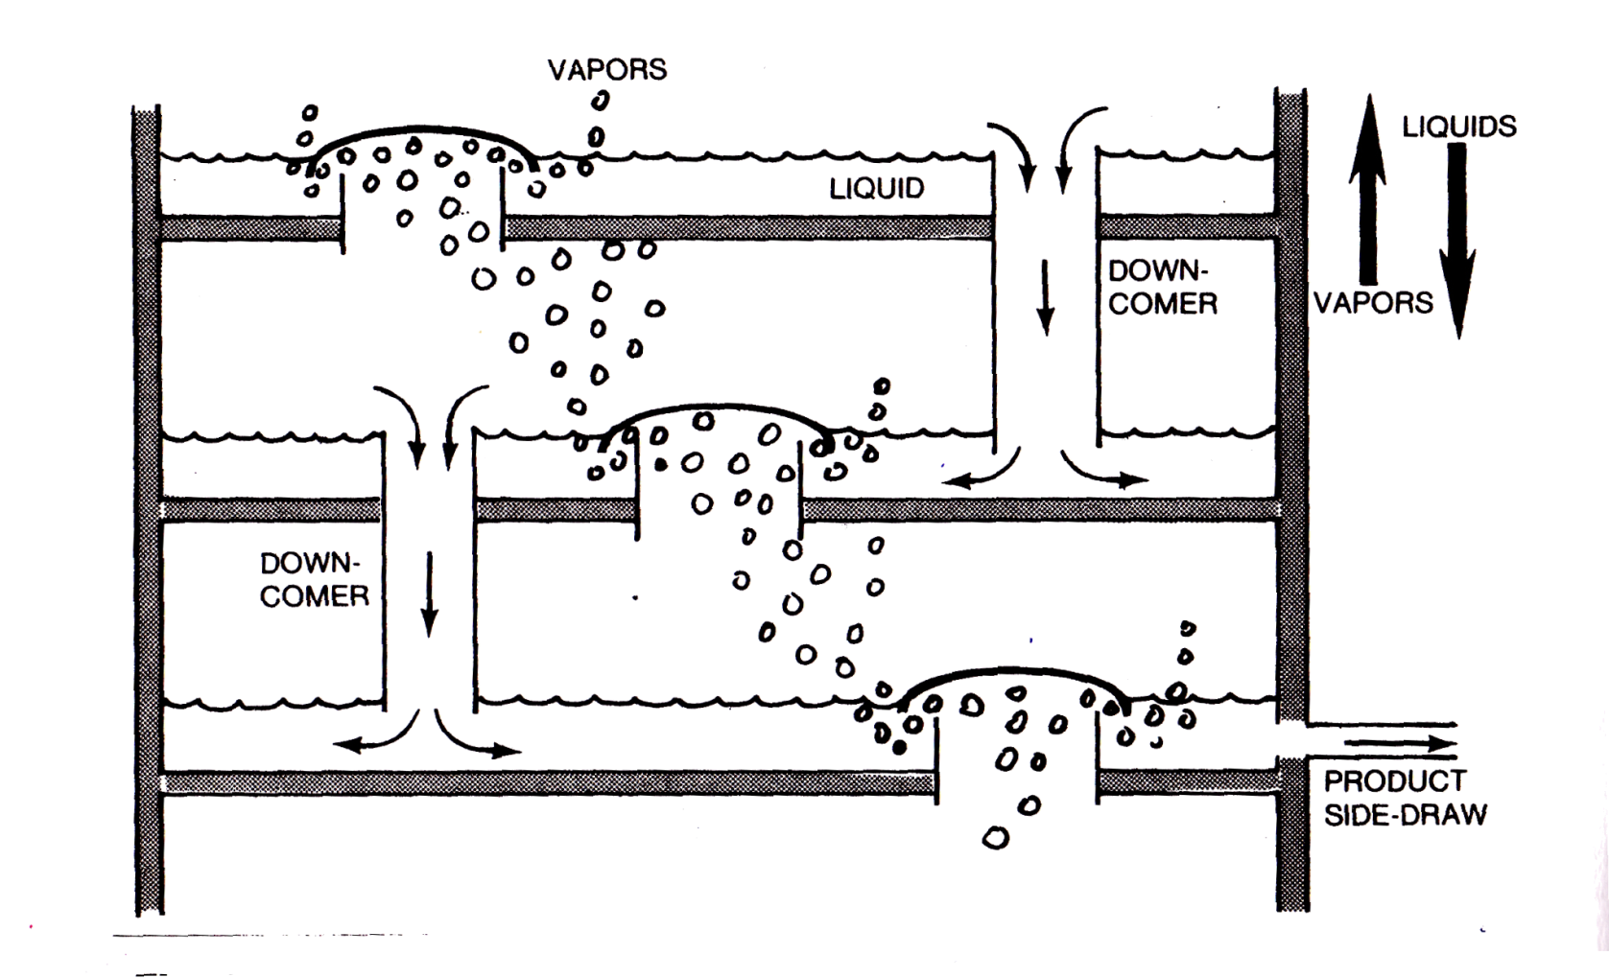
Distilling Crude Oil
The Distillation Column Design

Slide 43
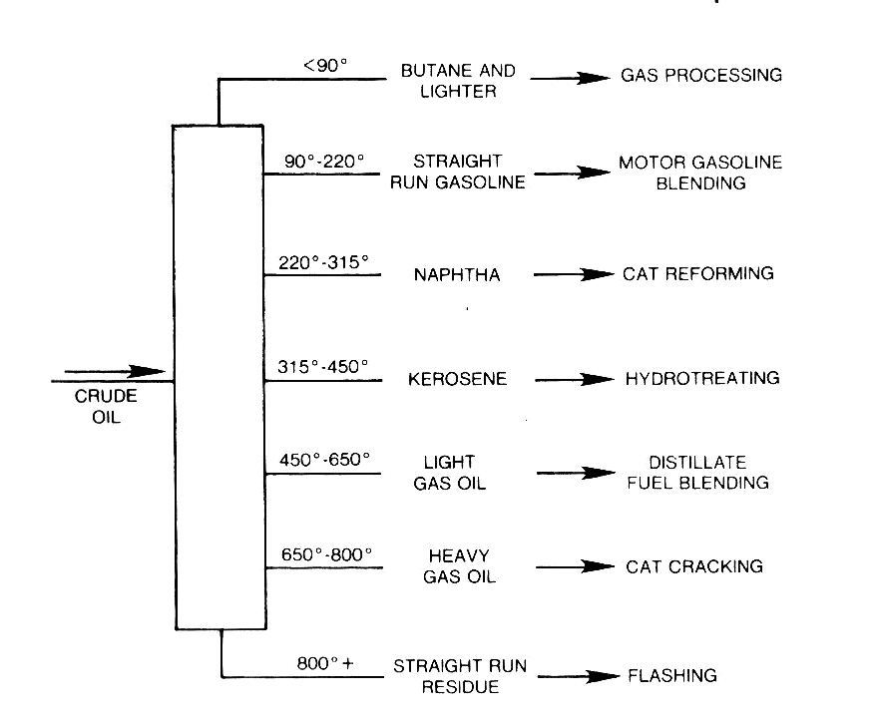
Distilling Crude Oil
The Distillation Column Design

Slide 44
Distilling Crude Oil
The Distillation Column Cont'd
Sent back to the column by reflux or withdrawn for processing in naphtha fractionation unit
Kerosene and light diesel cuts are withdrawn as sidestreams and steam stripped in steam strippers
Further cooled in heat exchangers and sent to storage
Hot atmospheric bottoms (reduced crude), at approx. 340 Deg. C, is transferred to vacuum tower heater

Slide 45
Distilling Crude Oil
What about the Crude that doesn't Evaporate?
Crude oil coming out of the bottom of the primary distillation tower, which did not boil off and is known as straight run, still contains valuable petroleum products which must be fractionated.
The highest, and heaviest, cut point in the primary distillation tower is at about 750 degrees Fahrenheit; most towers cannot handle going higher than this temperature.
So how do you crack the heaviest cuts without melting your distillation tower?

Slide 46
Distilling Crude Oil
The Vacuum Distillation Tower
To fraction off heavier crude oils, you have to cheat by using a lower pressure; thus you use a vacuum distillation tower. Using a lower pressure equates to a lower boiling temperature.
However, even though the straight run residue has flashed, it will not crack since the temperature is too low.
To keep the tower below atmospheric pressure, a vacuum pump or steam eductor is used.

Slide 47
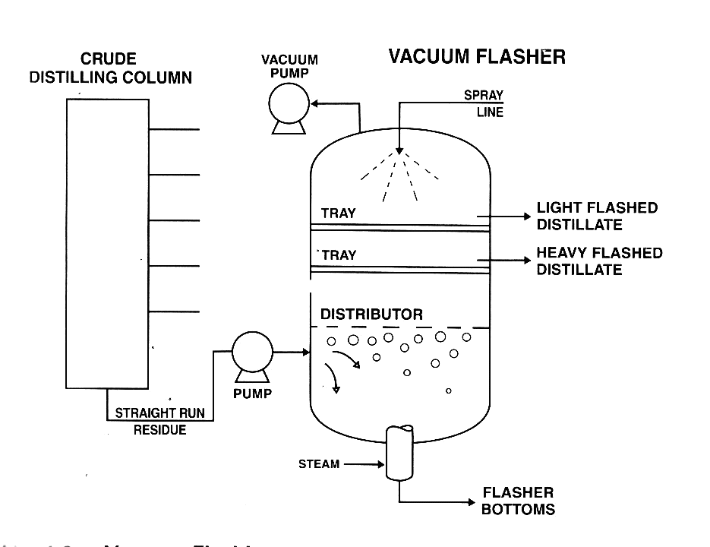
Distilling Crude Oil
The Vacuum Distillation Tower

Slide 48
Distilling Crude Oil
The Vacuum Distillation Tower Cont'd
The vacuum distillation tower is provided with a cold recycle (quench) to lower the bottom temperature and to avoid coking.
The heavy fractionated product (usually diesel) is drawn as a sidestream and exchanges heat with crude oil in the preheat train.
It is partly used as top and intermediate reflux to the column, and the balance is sent to storage after cooling.
Question: Why is coking in the vacuum distillation tower a bad thing?

Slide 49
Distilling Crude Oil
What is Refluxing and Reboiling?
The evaporation and condensation of crude oil must be kept in a certain equilibrium. However, conditions may form that upset the balance in the distillation tower which must be remedied.
One of these situations is the possibility of heavier hydrocarbons making their way up the tower and out through the top. To remove any heavy product that has manged to ascend the tower, the gases from the top extraction line are run through a cooler.
What this will do is condense the heavier hydrocarbons out of the lighter products. The heavier products, now in liquid state, will be reintroduced at a lower level in the tower. This is refluxing

Slide 50
Distilling Crude Oil
What is Refluxing and Reboiling?
If heavier hydrocarbons can work their way to the top of the tower, then lighter products can become entrained at the bottom.
To separate the lighter products from the heavier products, liquid crude is drawn off from the bottom of the tower and is heated up through a reboiler.
The lighter hydrocarbons will boil off and will be reintroduced at a higher level in the tower.
The advantage of a reboiler is that it can save a refinery energy and money since it only has to process a fraction of the total volume of crude in the tower to obtain additional recovery.

Slide 51
Distilling Crude Oil
What is Refluxing and Reboiling?
Reboiling can also be used in the middle of column as well to promote better separation of hydrocarbons. This is done by the reboiler adding heat to push lighter molecule up the column.
On the flip-side, the refluxing process can also be introduced at the middle of the column to help condense heavier molecules.
This comes in handy when dealing with a very light crude or a very heavy crude; adjusting the reboiling rate or reflux rate can ensure continuous separation of heavy and light hydrocarbons.
This also applied to “extreme distillation”

Slide 52
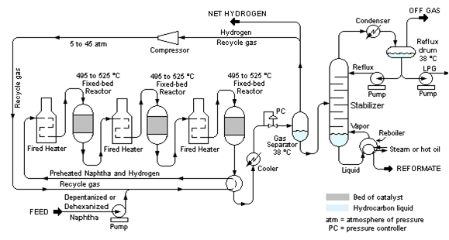
Distilling Crude Oil
Refluxing and Reboiling

Slide 53
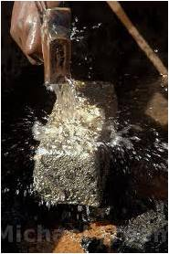
Catalytic Cracking and Crackling
Catalytic Cracking and Crackling
Overview
Flow and Process
Chemistry
Q & A

Slide 54
Catalytic Cracking and Crackling
A Quick Overview
Fluid Catalytic Cracking: cuts high-molecular weight hydrocarbon of crude oils to more valuable gasoline through a catalytic process.
Thermal cracking on its own is only 25 per cent efficient. Catalytic cracking on the other hand is 50 per cent efficient.
In 2007, fluid catalytic cracking created 834 million litres of product per day in USA; twice that amount worldwide.

Slide 55
Catalytic Cracking and Crackling
The Reactor
In the Reactor: Heavy Oil + Steam Catalyst --> Catalyst-Coke + Light Oil (Naphtha, fuel oil, off gas)
Feed to Catalyst riser (7) Cracking in reactor @ 535 degrees Celsius at 1.72 Bar (G)
Separate spent catalyst via hydrocarbon
Use 2 stages cyclones in reactor
Use steam to strip Hydrocarbon vapour

Slide 56
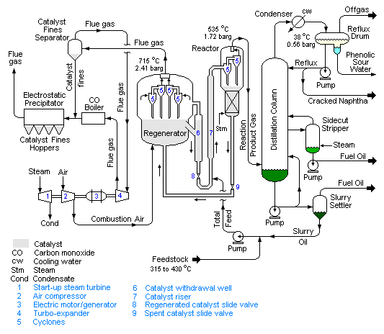
Catalytic Cracking and Crackling
The Reactor Flow

Slide 57
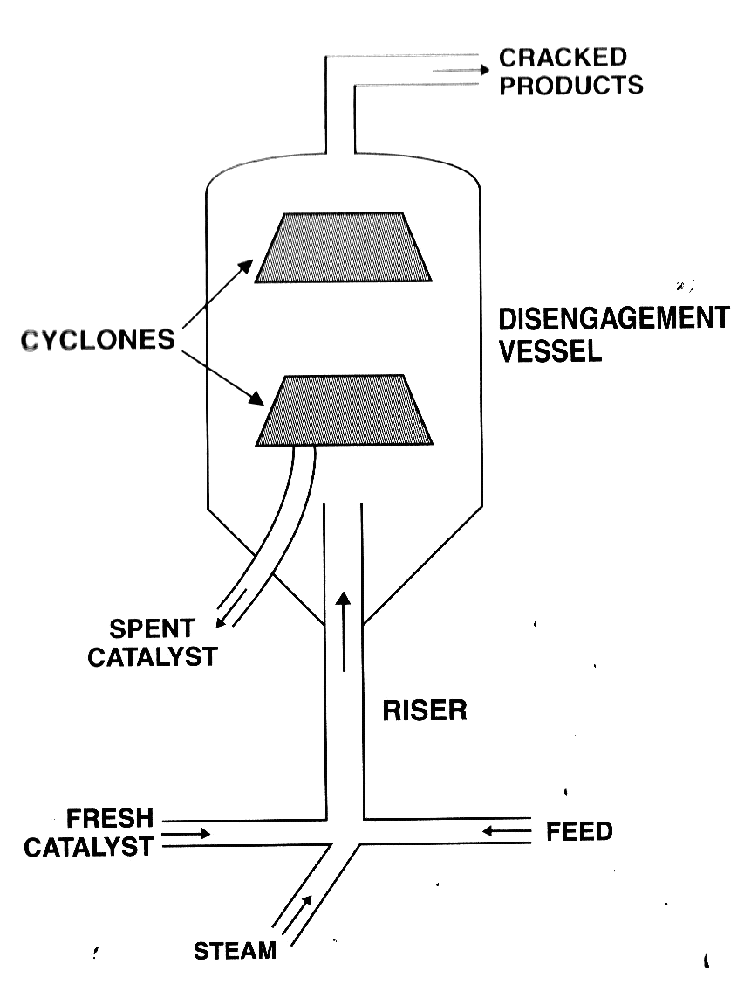
Catalytic Cracking and Crackling
The Reactor

Slide 58
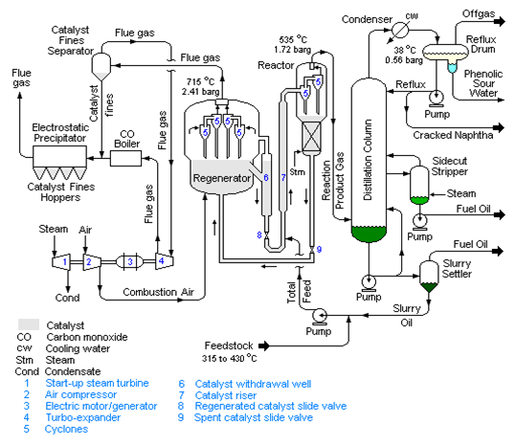
Catalytic Cracking and Crackling
The Regenerator
Catalyst is covered by coke and reduced
Uses combustion air to burn the coke off @ 715 degress Celsius , at 2.41 Bar (G)

Slide 59
Catalytic Cracking and Crackling
Treating the Flue Gas from the Regenerator
Flue gas from regenerating catalyst needs to be treated.
The Carbon-monoxide (CO) boiler burns carbon monoxide to generate steam.
The particles are removed via cyclones and electrostatic precipitation.
The produced steam is used to drive compressors which compress combustion air into the regenerator.

Slide 60
Catalytic Cracking and Crackling
The Flue Gas Flow

Slide 61
Catalytic Cracking and Crackling
The Distillation Column
After cracking, the mixture of cracked Naphtha, fuel oil needs to be distill into parts, such as butane, propane, burke C, etc

Slide 62
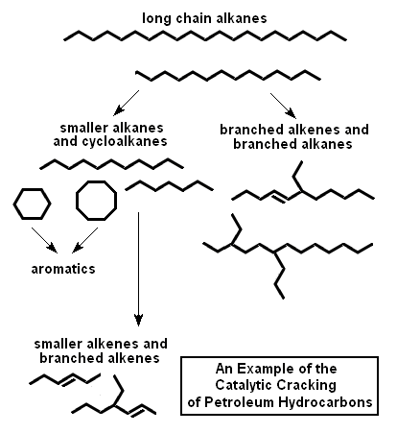
Catalytic Cracking and Crackling
Chemistry and Catalysts
Feedstock:

Slide 63
Catalytic Cracking and Crackling
The Catalyst
The basic requirements: A good catalyst has to have stability when subjected to high temperatures, be highly active, have large pore sizes, good resistance to attrition and low-coke production.
An example is Crystalline Zeolite

Slide 64
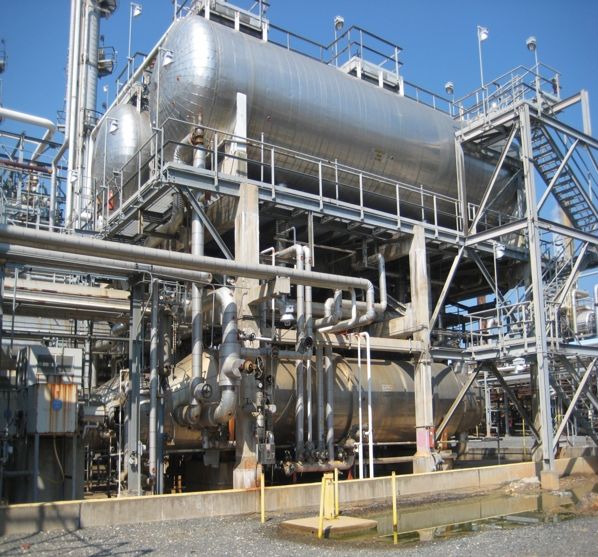
The Alkylation Unit
The Alkylation Unit
A Quick Introduction
The Process
Process Variables
The Final Product

Slide 65
The Alkylation Unit
A Quick Introduction
The light products generated from the catalytic cracking still need to be refined.
Also, leaving the butylenes and propylene in the gasoline blends was not a good idea (they are too volatile!)
Unlike catalytic cracking, alkylation takes smaller molecules and turns them into larger molecules.
The goal of alkylation is to react propylene or butylene with an isobutane to form an iso-paraffin called alkylate

Slide 66
The Alkylation Unit
The Process
The process consists of seven main parts
The chiller
The reactors
The acid seperator
The caustic wash
Three distilling columns
The catalyst can either be sulphuric acid or hydrofluoric acid.

Slide 67
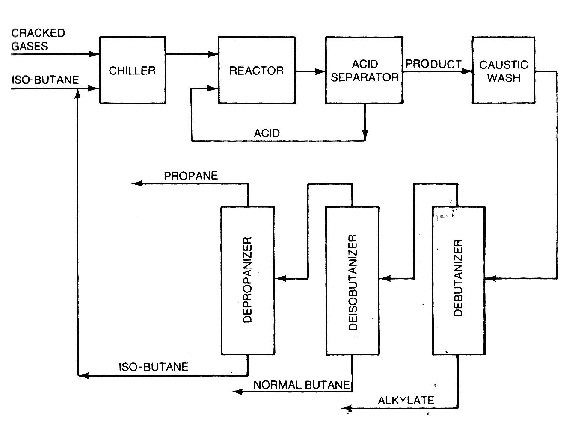
The Alkylation Unit
The Alkylation Unit

Slide 68
The Alkylation Unit
Process Variables
Reaction temperature: can lower product quality
Catalyst strength: can become diluted
The isobutane ratio: an excess is always better
Reaction time: can affect product quality

Slide 69
The Alkylation Unit
The Final Product
The final product, the alkylate, is a gasoline blender's dream.
It has a low vapour pressure, zero sulphur content, zero olefin content, zero benzene and a high octane number.
Other side products include propane and normal butane which are considered side effects of the process.

Slide 70
Thank You for Your Time

